Slide 1
THE SOUND OF MUSIC - II

Slide 2
EMPEROR Aurangzeb banned the playing of a musical
instrument called pungi in the royal residence for it had a
shrill unpleasant sound.
banned: prohibited
shrill: very sharp
unpleasant: something that you dislike

Slide 3
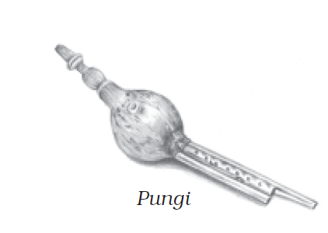

Slide 4
Pungi became the generic name for reeded noisemakers.
generic name: a name given to a class or group as a whole
Generic name means the scientific name or a broad classification of something
reeded: wind instruments which have reeds like the flute, the clarinet, etc

Slide 5
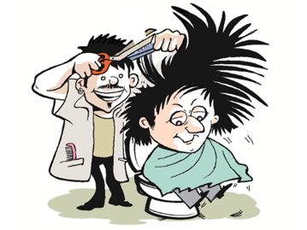
Few had thought that it would one day be revived.
revived: brought back to live.

Slide 6
A barber of a family of professional musicians, who had access to the royal palace, decided to improve the tonal quality of the pungi.
tonal quality: sound

Slide 7
He chose a pipe with a natural hollow stem that was longer and broader than the pungi, and made seven holes on the body of the pipe.
hollow: empty from inside.

Slide 8
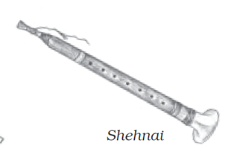

Slide 9
When he played on it, closing and opening some of these holes, soft and melodious sounds were produced.
He played the instrument before royalty and everyone was impressed.
The instrument so different from the pungi had to be given a new name.

Slide 10
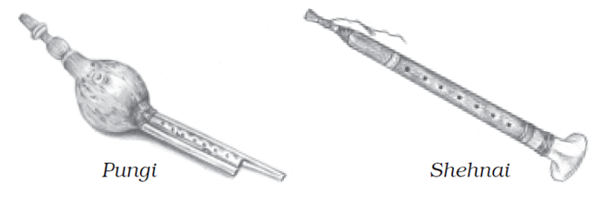

Slide 11
As the story goes, since it was first played in the Shah’s chambers and was played by a nai (barber), the instrument was named the ‘shehnai
The sound of the shehnai began to be considered auspicious.
auspicious: promising to bring good fortune
And for this reason it is still played in temples and is an indispensable component of any North Indian wedding.
indispensable: without which a piece of work cannot be done, something which is necessary

Slide 12
